Slide 1
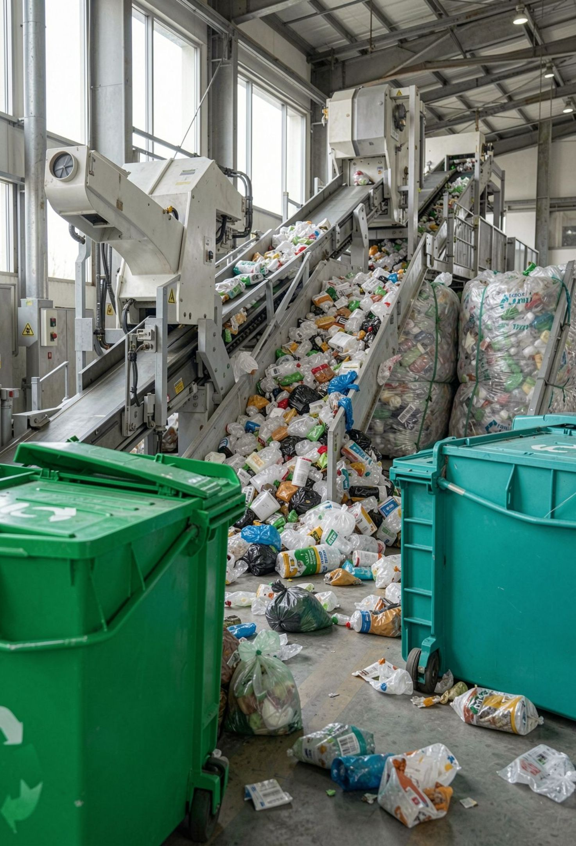
AI-Based Smart Waste Management and Recycling Prediction System
K V Pavan Kalyan — Model Development
K Phani Bhushan — Data Collection & Preprocessing
I Lakshmi — Model Evaluation
K Leela Prasanth — Frontend
Prasad V. Potluri Siddartha Institute of Technology · Computer Science and Engineering (CSE)

Slide 2
Problem Statement
Traditional waste management systems often rely on manual data collection and basic estimation methods, making it difficult to accurately predict daily waste generation and recycling rates. This can lead to inefficient waste collection, poor recycling planning, increased landfill usage, and improper allocation of resources.
Objectives
Predict daily waste generation
Estimate recycling rates and recyclable/residual waste
Analyze patterns by state, city, waste type, and season
Support municipalities and recycling centers with data-driven decision support

Slide 3
Existing system vs proposed system
Existing system
Proposed system
Relies on fixed assumptions or manual calculations.
Limited comparison across locations and seasons.
Slow reporting; recycling planning is separate from waste analysis.
Machine learning predicts waste generation and recycling rate.
Automated preprocessing and batch CSV prediction.
Interactive Streamlit dashboard supports decisions.

Slide 4





Project Design / Workflow
01
02
03
04
05
Data Collection
Data Preprocessing
Model Training
Prediction and Recycling Analysis
Streamlit Dashboard and Decision Support
25,203 records from Indian cities, 2015–2026
Linear Regression, Decision Tree, Random Forest
26 selected features → encoding → 36 model inputs
Waste generation, recycling rate, recyclable and residual waste
Streamlit filters, charts, CSV upload and batch prediction

Slide 5
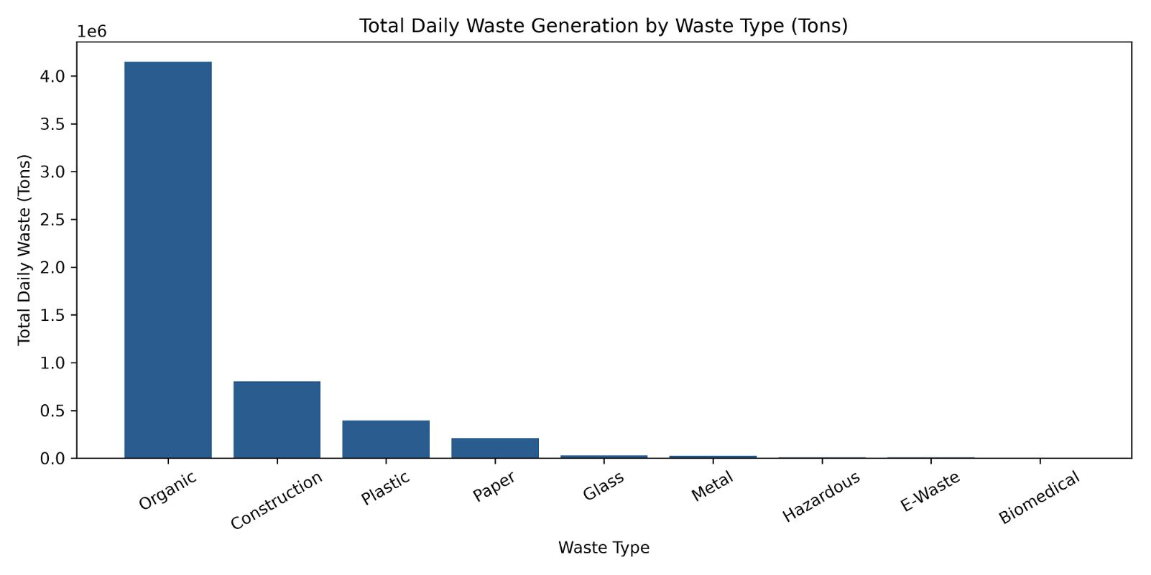
Dataset and preprocessing
Kaggle dataset: Waste_Management_India_20K.csv
Indian cities and states, with data from 2015–2026
26 selected domain features before encoding; 36 model input features after one-hot encoding
80:20 train-test split, random_state=42, and StandardScaler where appropriate
25,203
records
42
original columns

Slide 6
Algorithms and evaluation metrics
Linear Regression
MAE
Estimates a straight-line relationship between inputs and waste output.
Average absolute error; lower is better.
RMSE
Decision Tree Regression
Gives more weight to larger errors; lower is better.
Makes rule-based splits, such as by city or season.
R²
Random Forest Regression
Share of variation explained; closer to 1 is better.
MAE = mean |actual − predicted| · RMSE = √mean(actual − predicted)² · R² compares explained with total variation
Combines many decision trees for stability and accuracy.

Slide 7
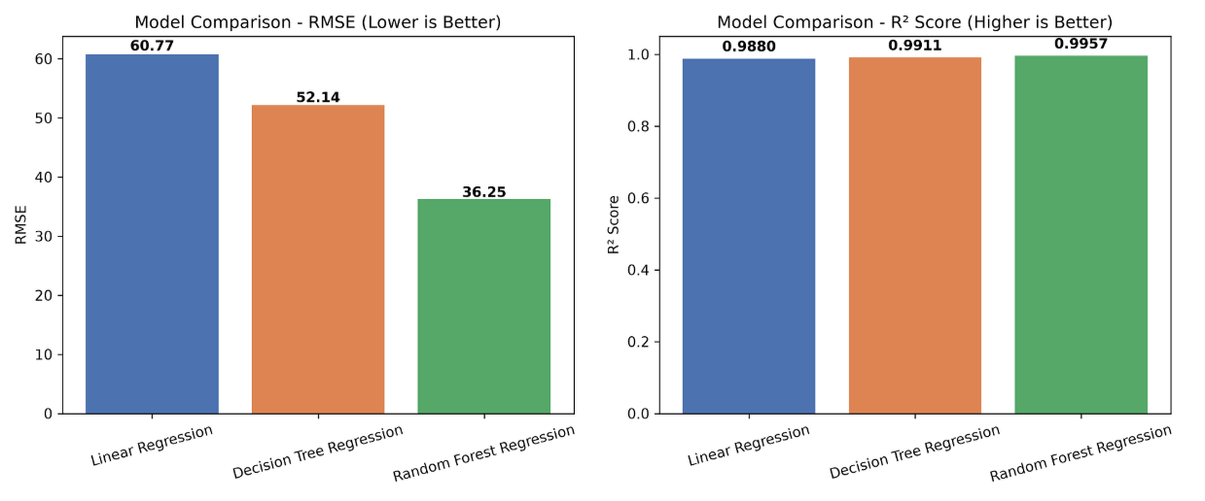
Waste generation model comparison
Model | MAE | RMSE | R²
Linear Regression | 20.2472 | 60.7695 | 0.9880
Decision Tree Regression | 14.4111 | 52.1382 | 0.9911
Random Forest Regression | 10.3137 | 36.2488 | 0.9957
Random Forest is the best-performing waste-generation model on all three metrics.

Slide 8
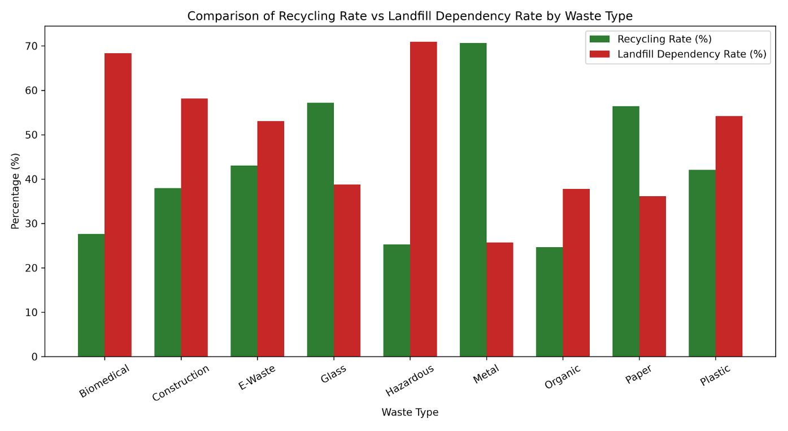
Recycling-rate model and calculations
Recycling-rate model
Recycling calculations
Production Linear Regression model, separate from the waste-generation model.
Recyclable Waste = Predicted Waste × Predicted Recycling Rate / 100
Residual Waste = Predicted Waste − Recyclable Waste
MAE: 3.2084 percentage points
RMSE: 4.0075 percentage points
R²: 0.9193
Sample scenario (illustrative): 44.9 tons/day predicted waste at a 39.1% recycling rate gives about 17.6 tons/day recyclable and 27.3 tons/day residual waste.

Slide 9
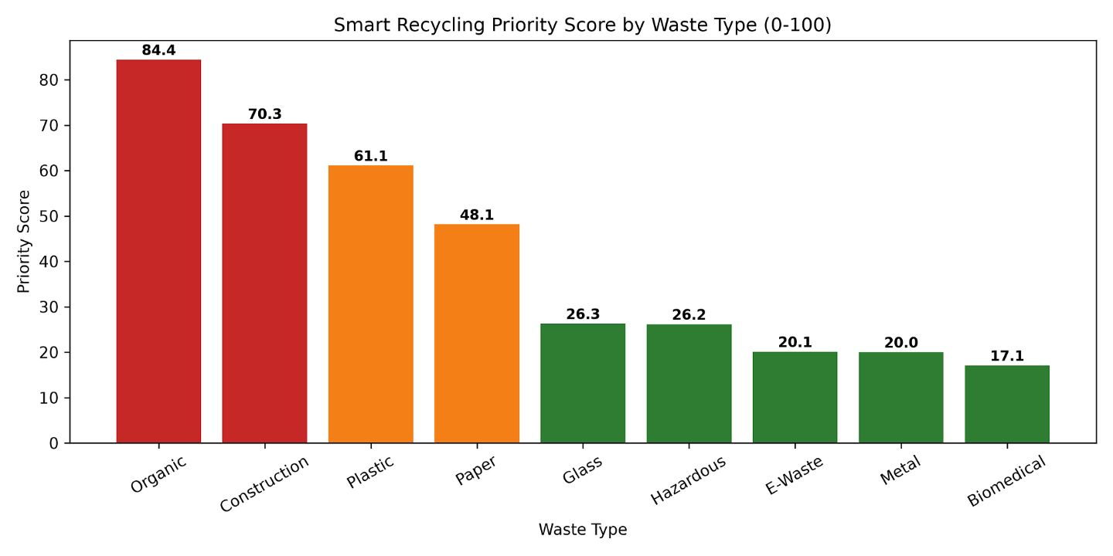
Dashboard, applications, limitations, and future scope
Dashboard and applications
Limitations and future scope
Streamlit Smart Waste Intelligence dashboard with filters, charts, CSV upload, and batch analysis.
Illustrative mockup, not a live screenshot.
Used by municipalities and recycling centers.
Future: waste forecasting, anomaly detection, what-if simulation, priority recommendations.
Limitations: data quality and generalization to new locations.
Future: additional datasets and periodic model retraining.
Real-time IoT integration is planned, not yet implemented.

Slide 10
Conclusion and Q&A
The project shows how machine learning can support smarter waste-management decisions, using 25,203 records from Indian cities.
Random Forest delivered the best waste-generation performance: MAE 10.3137, RMSE 36.2488, R² 0.9957.
The separate Linear Regression recycling-rate model achieved MAE 3.2084 percentage points, RMSE 4.0075 percentage points, R² 0.9193.
Prediction, recyclable and residual waste calculation, priority analysis, and dashboard insights help municipalities and recycling centers plan with better evidence.
Key takeaway: predict earlier, recover more, and reduce landfill dependence.
Thank You

